Slide 1
Image Captioning with semantic attention for visually impaired

Slide 2
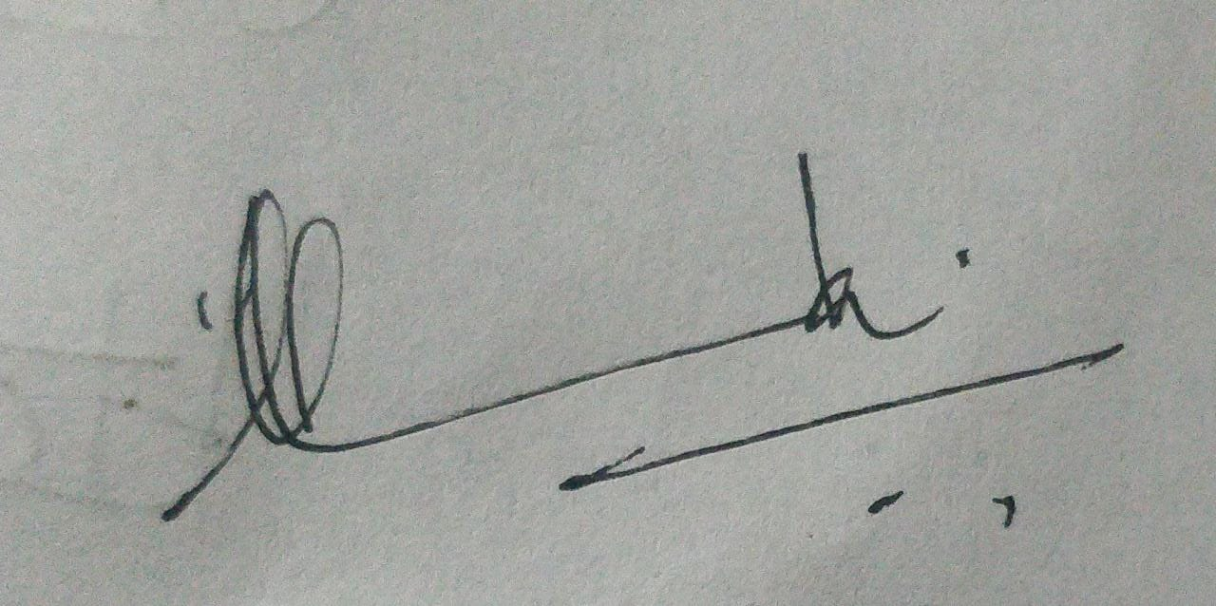
Team members
Guide
Prof. Dr. V. Mary Anita Rajam
Kavya S
2017103543
Raveena R
2017103577
Varsha A
2017103606

Slide 3
INTRODUCTION
Image captioning aims to provide machine-generated natural language captions for any given image
Our ability to effortlessly point out and describe all aspects of an image relies on a strong semantic understanding of a visual scene and all of its elements.
In this work, we mainly focus on improving the effectiveness of using the image attribute based semantic attention, considering that attributes contain both the high-level knowledge of the image content and specific semantics of corresponding captioning words.
The goal of this project is to help the visually impaired to understand an image with voice assistance and braille format of the generated caption.

Slide 4
OVERALL OBJECTIVES
To generate captions with rich semantic information for any given image, the following steps are to be followed.
Extraction of object features from the input image.
Predicting the probability of image attributes to choose features with rich semantics for better captioning.
Predicting the subsequent attributes that are highly relevant to current linguistic context for generating plausible image captions
Conversion of generated captions to speech and braille format.

Slide 5
LITERATURE SURVEY
Early approaches on image captioning could be divided into two based on template matching and retrieval-based approaches.[1] The captions generated by template matching is not always fluent and expressive.
Retrieval based approaches first retrieve the visually similarity images from a large database, and then transfer the captions of retrieved images to fit the query image[2].
Traditional encoder-decoder RNNs [3] deals with the sequence in a recurrent way, squeezing the information of all previous words into hidden cells and updating the context information by fusing the hidden states with the current word information. This may miss the rich knowledge too far in the past.[4]

Slide 6
LITERATURE SURVEY(cont.)
In order to boost the performance of encoder-decoder, visual attention was introduced [5].
CNN adopts a deep multimodal similarity model to re-rank the candidates to generate the final caption. [6]
Replacing the encoder RNN with Deep Convolutional Neural Network (CNN) by embedding it to a fixed-length vector, such that the representation can be used for a variety of vision tasks thereby improving the performance.[7]
To address the localization of images and description [8] proposes a Fully Convolutional Localization Network (FCLN) architecture that processes an image with a single, efficient forward pass, requires no external regions proposals, and can be trained end-to-end with a single round of optimization.

Slide 7
LITERATURE SURVEY(cont.)
[9] A Semantic Compositional Network (SCN) is for image captioning, in which semantic concepts are detected from the image, and the probability of each semantic concept is used in a long short-term memory (LSTM) network. The SCN extends LSTM for ensembling the semantic concepts .
[10] Digital Signal Processing does two types of synthesis methods which are rule-driven methods and data-driven methods. Text to speech synthesis module is used to convert the generated caption into audio format.
[11] converts the generated caption into braille format which can be then printed for future references.

Slide 8
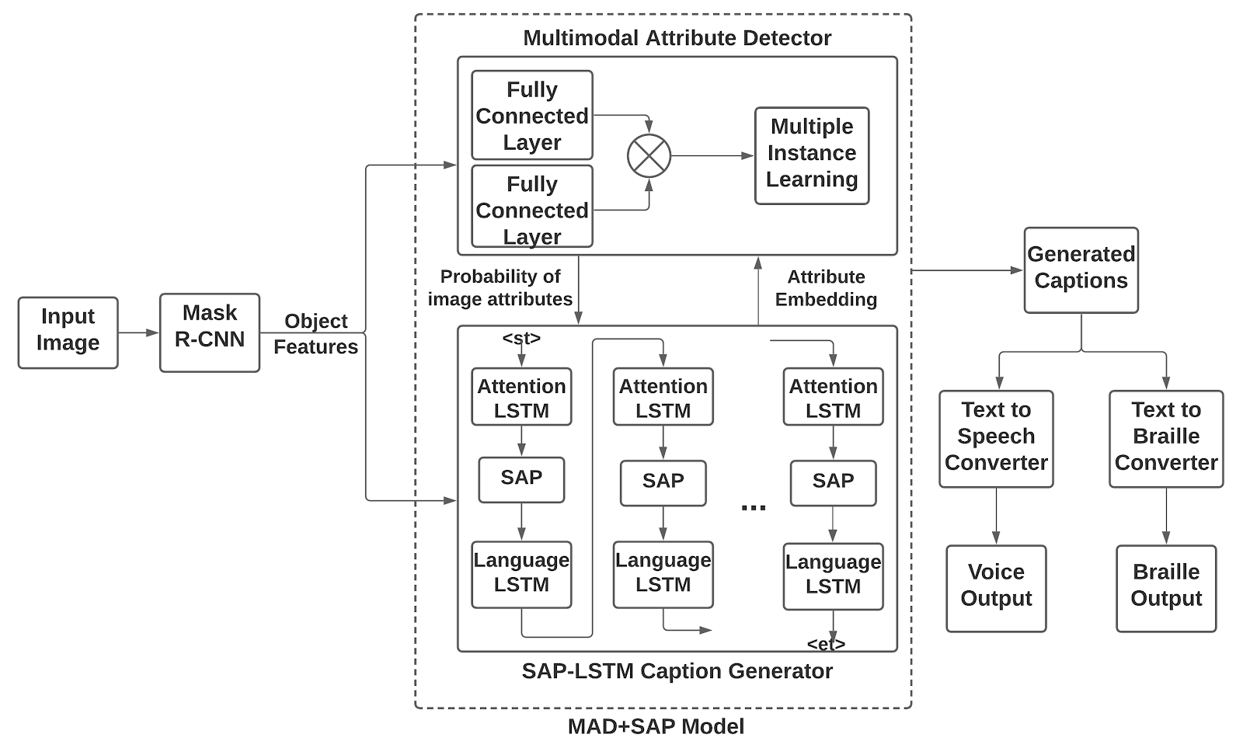
BLOCK DIAGRAM

Slide 9
BLOCK DIAGRAM
The object features are extracted from the input image using Mask R-CNN
From the extracted features, MAD computes the probability of whether an attribute is contained in the input image.
The Attention LSTM helps in prediction of subsequent attributes and distinguishes the importance of different object features.
SAP uses the probability computed by MAD and the output of Attention LSTM to choose the most relevant subsequent attribute at each time.
The subsequent attributes of top-k probabilities chosen in SAP are fed to Language LSTM to check the semantics of the generated partial caption and a semantically accurate caption is generated.
The caption generated with semantic attention is given to text to speech converter and text to braille converter which converts the caption to voice and braille format so that the visually impaired will be able to understand any image.

Slide 10
LIST OF MODULES
Mask R-CNN
Multimodal Attribute Predictor
Subsequent Attribute Predictor
Text to Speech converter
Text to Braille converter

Slide 11
DETAILS OF MODULES

Slide 12
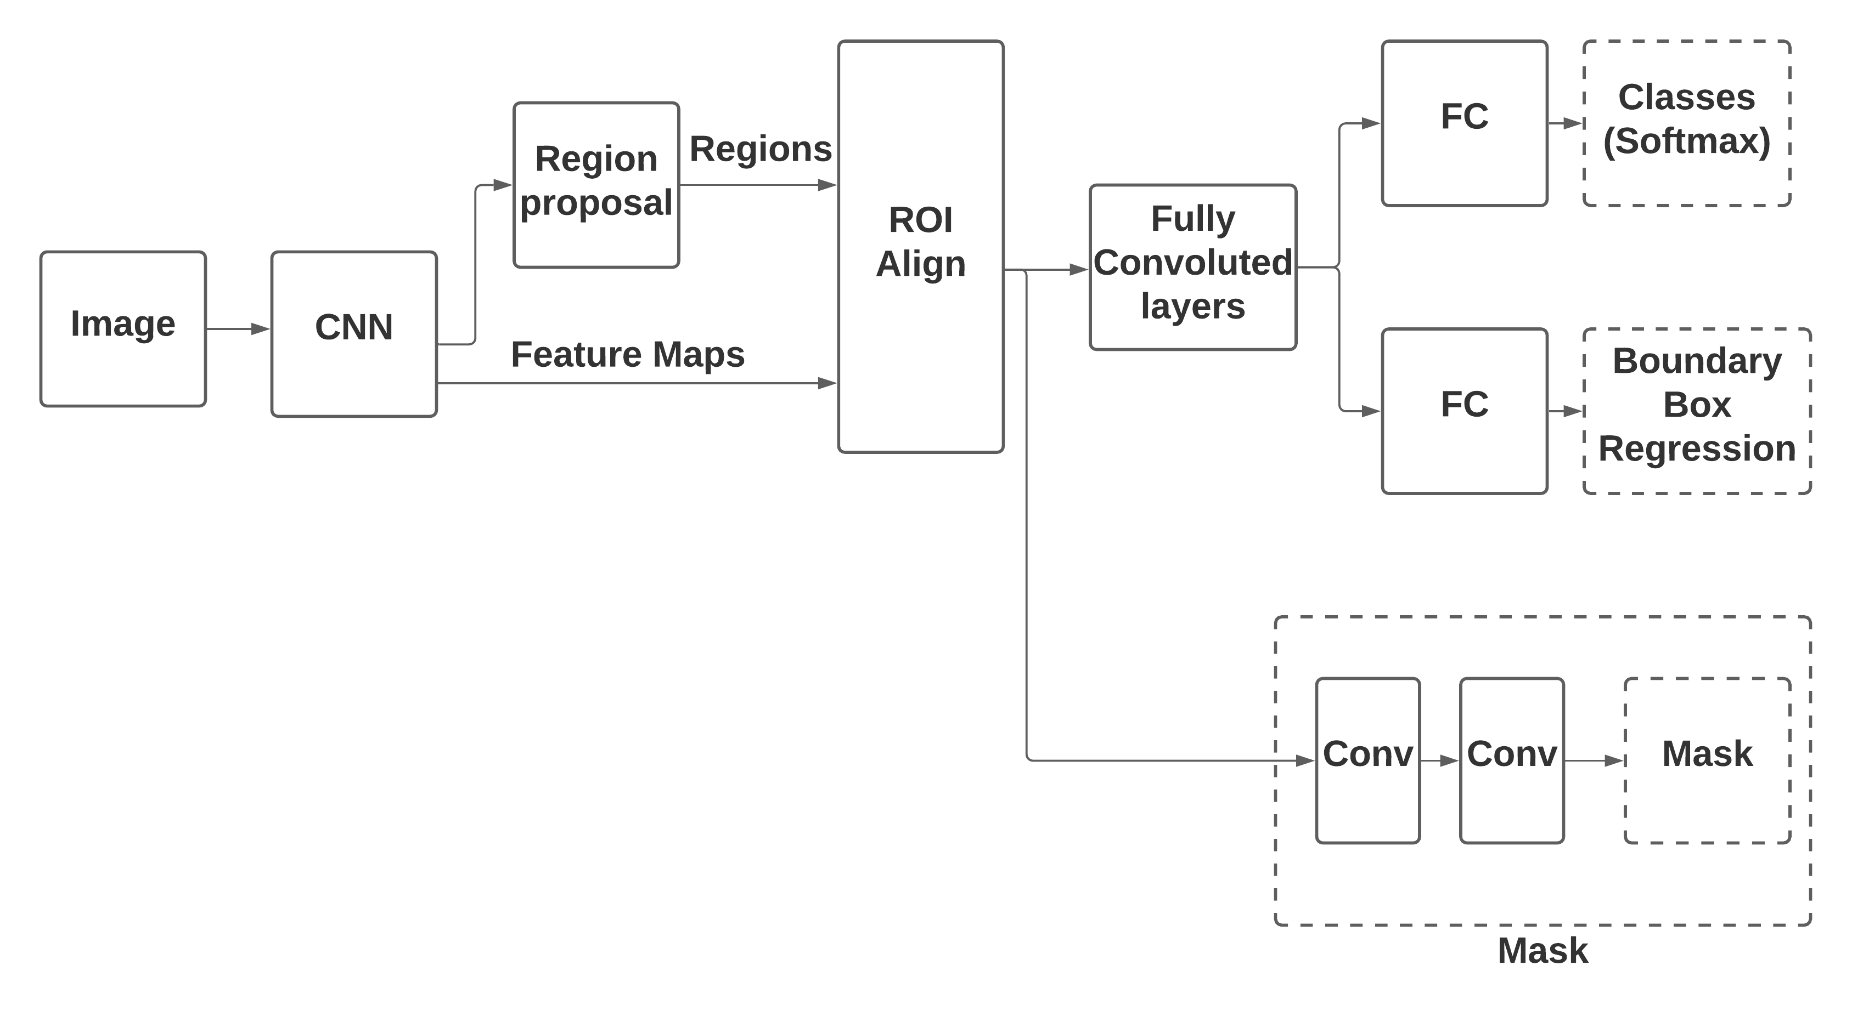
MASK R-CNN

Slide 13
MASK R-CNN
Mask R-CNN is a state of the art model for instance segmentation, developed on top of Faster R-CNN with additional branches for predicting segmentation masks on each Region of Interest (RoI).
RoIAlign helps to preserve spatial information and uses binary interpolation to create a feature map that is of fixed size.
The output from the RoIAlign layer is then fed into Mask head, which consists of two convolution layers.
It generates a mask for each RoI, thus segmenting an image in pixel-to-pixel manner.

Slide 14
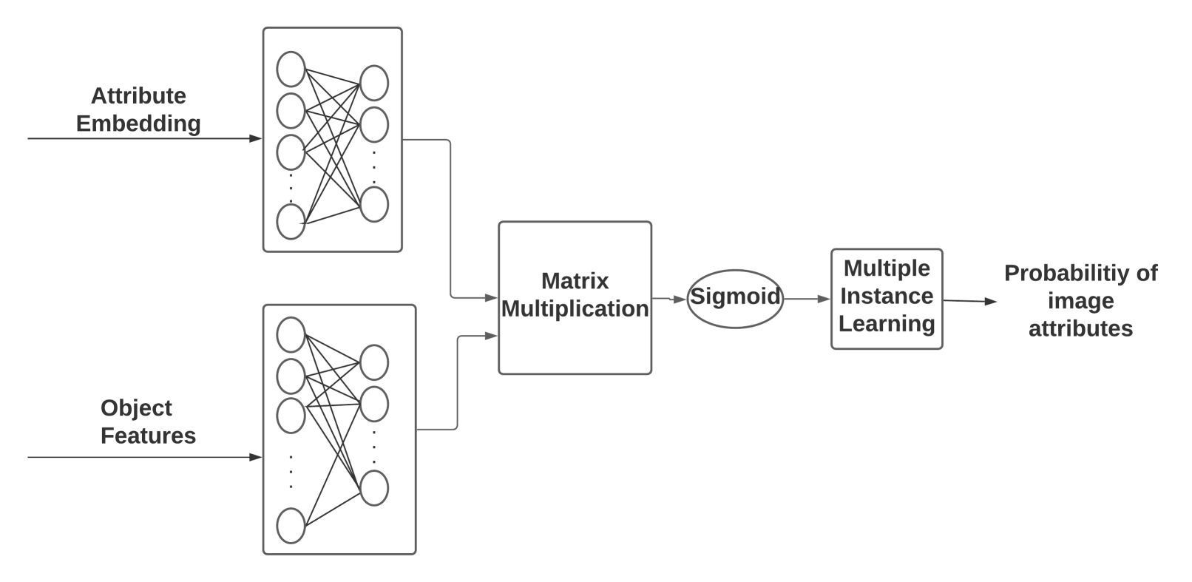
MULTIMODAL ATTRIBUTE DETECTOR

Slide 15
MULTIMODAL ATTRIBUTE DETECTOR
The Multimodal Attribute Detector predicts the probability of whether an attribute is contained in the input image using two steps:
The attribute embedding and object features are mapped to the same space using two fully connected layers. The outputs are merged using matrix multiplication to compute the similarity. The product is sent to the sigmoid layer which gives a raw probability matrix Praw where Prawij denotes the probability that jth object contains the ith attribute ai.
The raw probability values in each row of Praw are merged using noisy OR Multiple Instance Learning to predict the final probability pi that the input image contains the ith attribute ai.

Slide 16
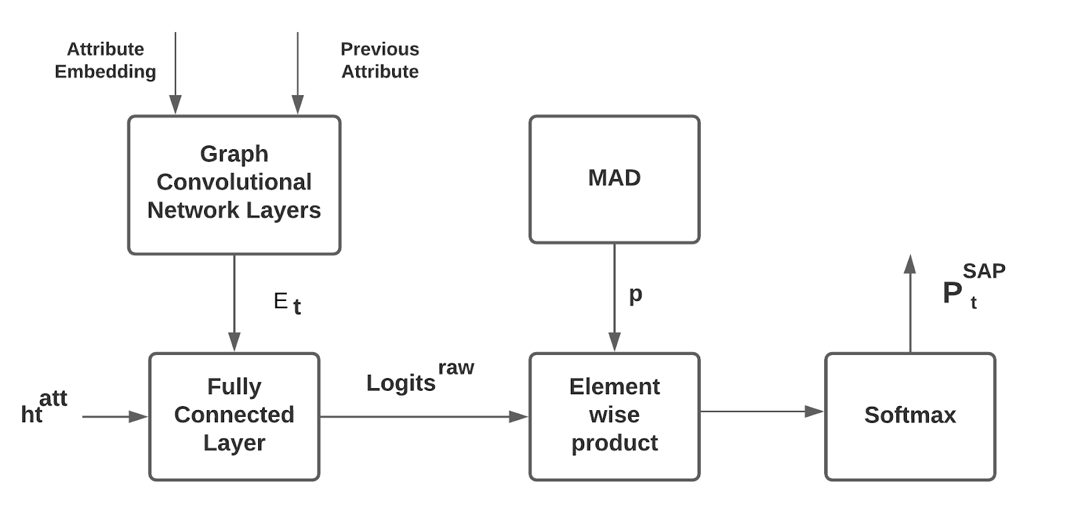
SUBSEQUENT ATTRIBUTE PREDICTOR

Slide 17
SUBSEQUENT ATTRIBUTE PREDICTOR
The Subsequent Attribute Predictor (SAP) predicts an appropriate subset of attributes, or subsequent attributes, to attend at each time step. It keeps the most relevant attribute at each time step and discards the other attributes.
The Graph Convolutional Network layer updates the embedding of attributes in order to refine the features of the attributes.
The Fully Connected Layer uses the output of Attention LSTM to distinguish the importance of different object features
The Element wise product layer generates the probability distribution of subsequent attributes.
Instead of choosing one attribute with maximum probability, top-K attributes are chosen as current subsequent attributes in order to prevent the model from using the wrong attribute when the top-1 subsequent attribute is erroneous.

Slide 18
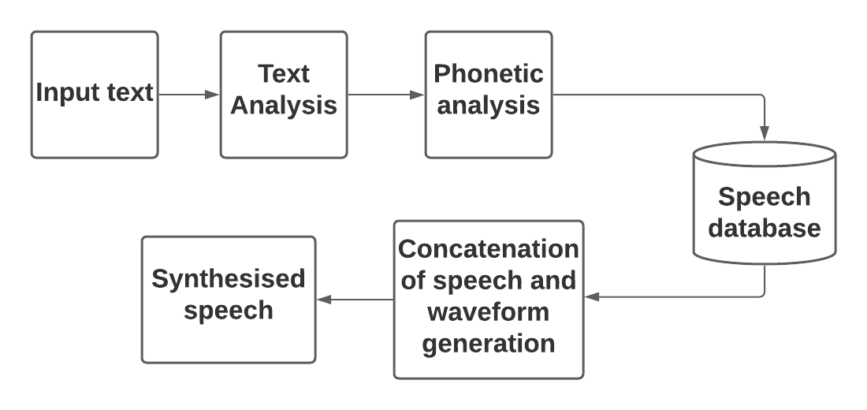
TEXT TO SPEECH CONVERTER

Slide 19
TEXT TO SPEECH CONVERTER
The Text-to-Speech synthesis procedure consists of two main phases.
The first one is text analysis, where the input document structure is detected, text is normalized and linguistic analysis is performed. Phonetic analysis identifies the homograph disambiguation and converts the grapheme to phoneme.
The second one is the generation of speech waveforms. The speech signal is generated by concatenating pre recorded sound units from the speech database and synthesised speech is generated as output.

Slide 20
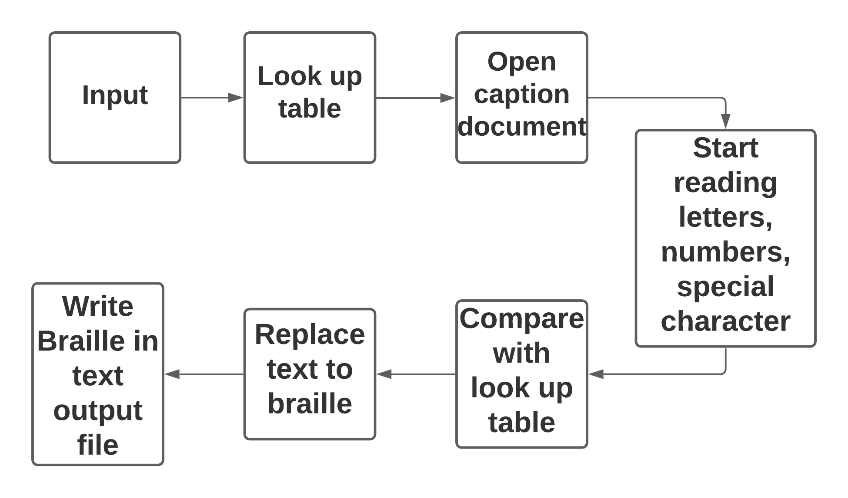
TEXT TO BRAILLE CONVERTER

Slide 21
TEXT TO BRAILLE CONVERTER
The input text indicates a word (.doc) or text (.txt) document that contains letters in the English language along with numbers and special characters.
In the LookUp table (LUT) all the braille codes for the 26 letters, 10 numbers and various special characters are written in an array or a table format.
Compare the letters with the LUT and convert them accordingly into Braille by switching text.
After the completion of the conversion process, the braille contents are written in the output file

Slide 22
PERFORMANCE MEASURES
BLEU (bilingual evaluation understudy) is an algorithm for evaluating the quality of text which has been machine-translated from one natural language to another. “The closer a machine translation is to a professional human translation, the better it is" – this is the central idea behind BLEU.
METEOR (Metric for Evaluation of Translation with Explicit ORdering) is a metric for the evaluation of machine translation output. The metric is based on the harmonic mean of unigram precision and recall, with recall weighted higher than precision.

Slide 23
PERFORMANCE MEASURES (Cont.)
ROUGE, or Recall-Oriented Understudy for Gisting Evaluation, is a set of metrics used for evaluating automatic summarization and machine translation software in NLP. The metrics compare an automatically produced summary or translation against a reference (human-produced) summary or translation.
CIDEr-D Consensus-based Image Description Evaluation, A version of CIDEr named CIDEr-D is available as a part of MS COCO evaluation server to enable systematic evaluation and benchmarking.
SPICE is Semantic Propositional Image Caption Evaluation. SPICE captures human judgments over model-generated captions better than other automatic metrics (evaluated over a range of models and datasets). It measures how well caption generators recover objects, attributes and the relations between them.

Slide 24
DATASET
This project evaluates model performance on the MS-COCO captioning dataset.
MS-COCO is a large-scale object detection, segmentation, and captioning dataset.
It uses 5000 images for validation and 5000 images for testing from the 40504 validation set following the widely adopted Karpathy’s data split.

Slide 25
REFERENCES
[1] A. Farhadi, M. Hejrati, M. A. Sadeghi, P. Young, C. Rashtchian, J. Hockenmaier, and D. Forsyth. “Every picture tells a story: Generating sentences from images.” In ECCV, pages 15–29, 2010.
[2] M. Hodosh, P. Young, and J. Hockenmaier. Framing image description as a ranking task: Data, models and evaluation metrics. Journal of Artificial Intelligence Research, 47:853– 899, 2013
[3] O. Vinyals, A. Toshev, S. Bengio, and D. Erhan, “Show and tell: A neural image caption generator,” in Proc. IEEE Conf. Comput. Vis. Pattern Recognit., Jun. 2015, pp. 3156–3164
[4] Q. You, H. Jin, Z. Wang, C. Fang, and J. Luo, “Image captioning with semantic attention,” in Proc. IEEE Conf. Comput. Vis. Pattern Recognit., Jun. 2016. pp. 4651 - 4659

Slide 26
REFERENCES (CONT.)
[5] P. Anderson et al., “Bottom-up and top-down attention for image captioning and visual question answering,” in Proc. IEEE Conf. Comput. Vis. Pattern Recognit., vol. 3, no. 5, Jun. 2018, p. 6.
[6] H. Fang, S. Gupta, F. Iandola, R. K. Srivastava, L. Deng, P. Dollar, J. Gao, X. He, M. Mitchell, J. C. Platt, et al. From ´ captions to visual concepts and back. In CVPR, pages 1473– 1482, 2015
[7] Hartati,Hanif Al Fatta, and Utsman Fajar, “Captioning Image Using Convolutional Neural Network (CNN) and Long-Short Term Memory (LSTM)” in IEEE International Seminar on Research of Information Technology and Intelligent Systems (ISRITI), 2019, pp. 263-268
[8] Justin Johnson Andrej Karpathy Li Fei-Fei, “DenseCap: Fully Convolutional Localization Networks for Dense Captioning” in Proc. Dec 2016 IEEE Conference on Computer Vision and Pattern Recognition.pp. 4565-4574

Slide 27
REFERENCES (CONT.)
[9] Z. Gan et al., “Semantic compositional networks for visual captioning,” in Proc. IEEE Conf. Comput. Vis. Pattern Recognit., vol. 2, Jul. 2017. pp. 1141 - 1150
[10] Zhigang Yin, “An Overview of Speech Synthesis Technology”, in Proc. 2018 International Conference on Instrumentation, Measurement, Computer, Communication and Control (IMCCC), Mar. 2020, pp. 522-526
[11] Kimaya Kulkarni Apoorva Mahajan Yash Zambre “Text Detection and Communicator Using Braille for Assistance to Visually Impaired” in Conf.,2019 IEEE Pune Section International Conference (PuneCon), pp. 1-5

